Slide 1
Blood Sugar Monitoring using Pervasive Computing Technologies
MEMBERS:
K.Shenbagaram
R.Vijayarajan
J.Praveen Kumar
GUIDE:
Dr.T.Revathi
Department of IT

Slide 2
Work Completed
Constructing the glucometer circuit.
Getting the reading from glucometer and transmitting the reading.
Mailing the reading to the mail ID specified.
Department of IT

Slide 3
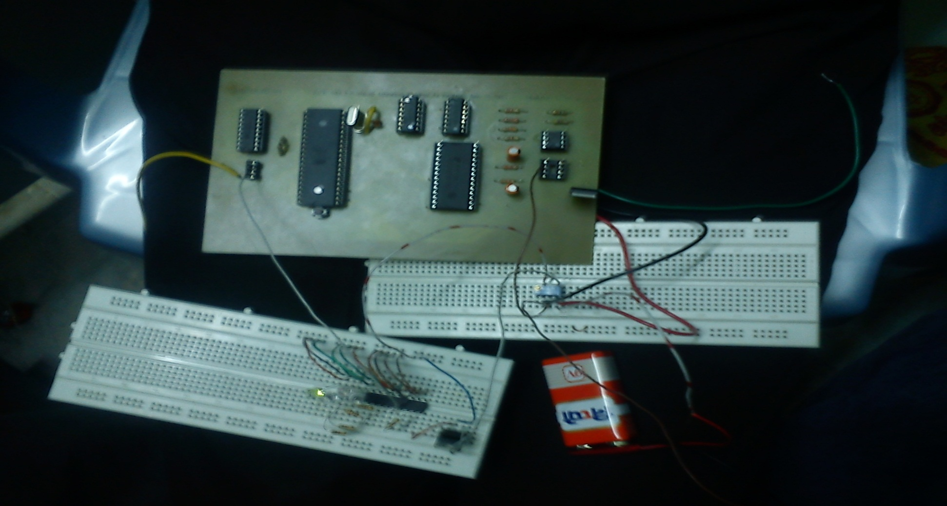
Glucometer and Transmitter Circuit
Department of IT

Slide 4
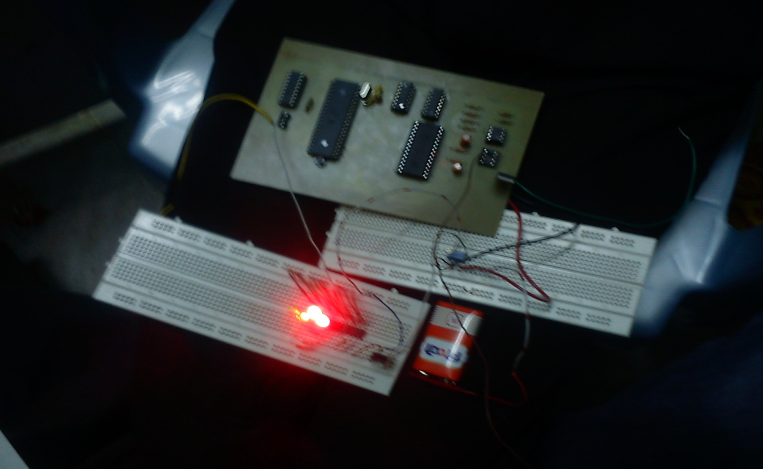
Contd.
Department of IT

Slide 5
Mail Code
import javax.mail.*;
import javax.mail.internet.*;
import java.util.*;
public class Mailer {
String d_email = "praveen.flash@gmail.com",
d_password = "b@r@thkum@r",
d_host = "smtp.gmail.com",
d_port = "465",
m_to = "praveen.flash@hotmail.com",
m_subject = "Hi da bther",
m_text = "The test mail.......hellloooooooooooooooooooooooooooooooooo";
Department of IT

Slide 6
Contd.
public Mailer() {
Properties props = new Properties();
props.put("mail.smtp.user", d_email);
props.put("mail.smtp.host", d_host);
props.put("mail.smtp.port", d_port);
props.put("mail.transport.protocol", "smtps");
props.put("mail.smtps.auth", "true");
props.put("mail.smtps.debug", "true");
props.put("mail.smtps.socketFactory.port", d_port);
props.put("mail.smtps.socketFactory.class","javax.net.ssl.SSLSocketFactory");
props.put("mail.smtps.socketFactory.fallback", "false");
Department of IT

Slide 7
Contd.
try {
Authenticator auth = new SMTPAuthenticator();
Session session = Session.getInstance(props, auth);
session.setDebug(true);
MimeMessage msg = new MimeMessage(session);
msg.setText(m_text);
msg.setSubject(m_subject);
msg.setFrom(new InternetAddress(d_email));
msg.addRecipient(Message.RecipientType.TO, new InternetAddress(m_to));
Transport tr = session.getTransport("smtps");
tr.connect(d_host, 465, d_email, d_password);
msg.saveChanges();
tr.sendMessage(msg, msg.getAllRecipients());
tr.close();
Department of IT

Slide 8
Contd.
} catch (Exception mex) {
System.out.println(mex);
}
}
public static void main(String[] args) {
Mailer blah = new Mailer();
System.out.println("Mail Sent");
}
private class SMTPAuthenticator extends javax.mail.Authenticator {
@Override
public PasswordAuthentication getPasswordAuthentication() {
return new PasswordAuthentication(d_email, d_password);
}
}
}
Department of IT

Slide 9
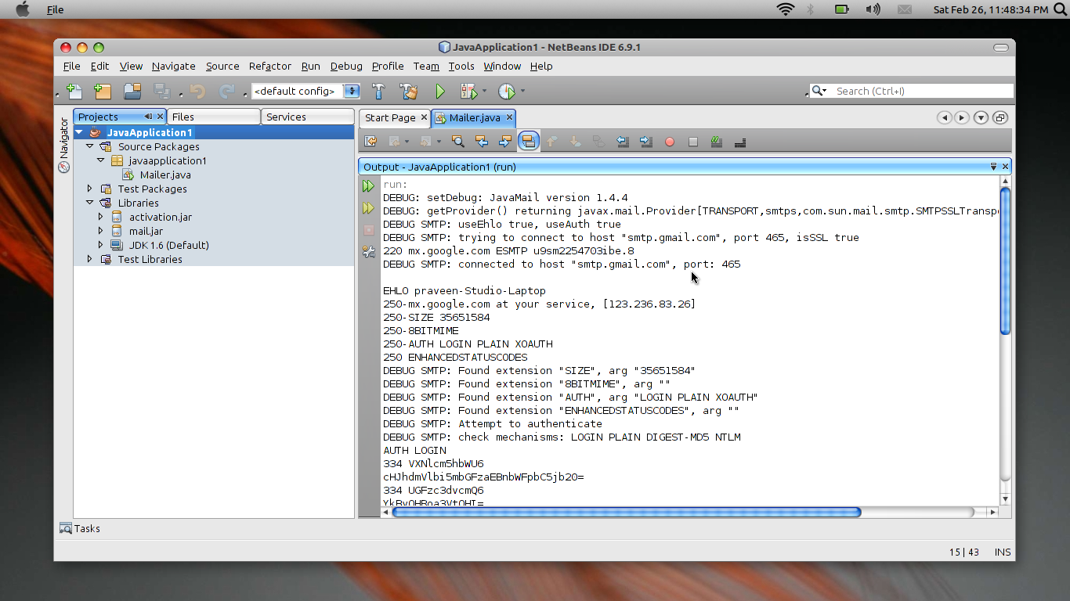
Snap Shot
Department of IT

Slide 10
Work Remaining
Make PCB for the receiver circuit
Receive data on computer via parallel port
Integrate all modules and test them.
Department of IT

Slide 11
THANK YOU
Department of IT

